Slide 1



C# OOP Basics
Course Introduction
C#
SoftUni Team
Technical Trainers
Software University
http://softuni.bg

Slide 2
Questions
sli.do #8191

Slide 3









SoftUni Diamond Partners

Slide 4
C# Web Profession
C# Fundamentals Module
C# OOP Basics
Fully supported by Microsoft
~500 Offers @ Jobs.BG
Scope
Trainers
Evaluation

Slide 5
C# Web Profession
C# Fundamentals Module
C# OOP Basics
Algorithmic and Conceptual Courses
Prelude to Database and Web Technology Courses
Scope
Trainers
Evaluation

Slide 6
C# Web Profession
Concepts of OOP
C# Fundamentals Module
Writing high quality code
C# OOP Basics
Scope
Trainers
Evaluation

Slide 7
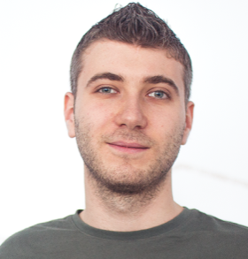
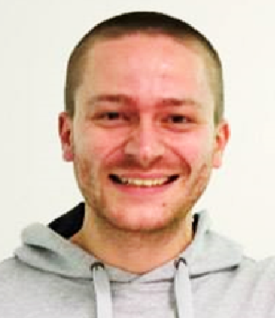
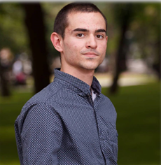

C# OOP Basics
Scope
Trainers
Evaluation

Slide 8
Trainers
Ivan Yonkov
Training Lead & Trainer @ SoftUni
5 years of programming experience mainly with Java and PHP
Solid experience as QA engineer
Top performing student from the Software University (2014)

Slide 9
Trainers
Ivaylo Kenov
Freelance Developer and Trainer
Mathematical competitions champion
Champion from Telerik Software Academy

Slide 10
Trainers
Bozhidar Gevechanov
Technical Trainer @ Software University
Top performing student from the Software University
Interests in Game Development, mainly in C#

Slide 11
Trainers
Svetlin Galov
Technical Trainer @ Software University
Top performing student from the Software University
Deep interest in Data Structures, Algorithms and Artificial Intelligence
Graduated from Business Academy of Aarhus (Denmark) with AP in Multimedia Design and Communications ( http://eaaa.dk )

Slide 12
Trainers
C# OOP Basics
Scope
Evaluation

Slide 13
Examination
Activities
Bonuses
Forum Activity
Attendance
1 problem
C# OOP Basics
75%
25%
10%
80% hand check
10%
10%
5%
Scope
Trainers
Evaluation
20% judge check
Teamwork Project
Exercises
Labs

Slide 14
C# Web Profession
C# Fundamentals Module
C# OOP Basics
Scope
Trainers
Evaluation

Slide 15









Resources
What We Need Additionally?

Slide 16

Course Web Site & Forums
The C# Advanced official web page:
Register for the "Software University Forum":
Discuss the course exercises with your colleagues
Find solutions for all course exercises
Share source code / discuss ideas / help each other
https://softuni.bg/c-sharp-basics-oop https://softuni.bg/courses/csharp-oop - old instances
http://softuni.bg/forum

Slide 17



The C# OOP Basics Slides and Videos
All lecture slides, videos, exercises, projects and other resources are open content, available for free
Visit the course web site to access the course resources

Slide 18

The Free C# Fundamentals Textbook
The official textbook for the course
"Fundamentals of Computer Programming with C#", by Svetlin Nakov & Co., 2013, ISBN 9789544007737
English and Bulgarian versions (as PDF, ePub, …)
Freely downloadable from: www.introprogramming.info
The C# Programming courses @ SoftUni.bg partially follows the book

Slide 19


Required Software
Software needed for this course:
Microsoft Windows (Win 10 / 8.1 / Win8 / Win7)
Visual Studio Community 2015 (a free version of VS 2015)
Visual Studio 2013, 2012, 2010 acceptable, but not recommended
.NET Framework 4.6 (included in Visual Studio)

Slide 20
C# OOP Basics – Course Intro
https://softuni.bg/c-sharp-basics-oop

Slide 21
License
This course (slides, examples, demos, videos, homework, etc.) is licensed under the "Creative Commons Attribution-NonCommercial-ShareAlike 4.0 International" license
Attribution: this work may contain portions from
"Fundamentals of Computer Programming with C#" book by Svetlin Nakov & Co. under CC-BY-SA license

Slide 22






Free Trainings @ Software University
Software University Foundation – softuni.org
Software University – High-Quality Education, Profession and Job for Software Developers
softuni.bg
Software University @ Facebook
facebook.com/SoftwareUniversity
Software University @ YouTube
youtube.com/SoftwareUniversity
Software University Forums – forum.softuni.bg

